Slide 1
Teaching cybersecurity: a practical path to increase user’s awareness
BROKEN ACCESS CONTROL – intermediate LEVEL

Slide 2
ACCESS CONTROL
Grant or restrict users’ rights on the application
Ensure that users cannot act outside their intended permissions

Slide 3
COMMON ACCESS CONTROL VULNERABILITIES INCLUDE
Violation of the principle of least privilege
Bypassing access control checks by modifying the URL, internal application state or HTML page
Permitting viewing or editing someone else’s account
Accessing APIs with missing access control for different methods
Elevation of privilege
Force browsing to pages

Slide 4
Cross site request forgery
An attack that tricks the victim into submitting a malicious HTTP request to a target destination without their knowledge or intent, in order to perform an action disguised as the victim

Slide 5
STORED CSRF
Attackers can store the attack on the vulnerable site itself
For example by using <img> or <iframe> tags on fields that accept HTML

Slide 6
Csrf steps
Building an exploit:
URL
SCRIPT
Trick the victim into executing the action:
Social engineering

Slide 7
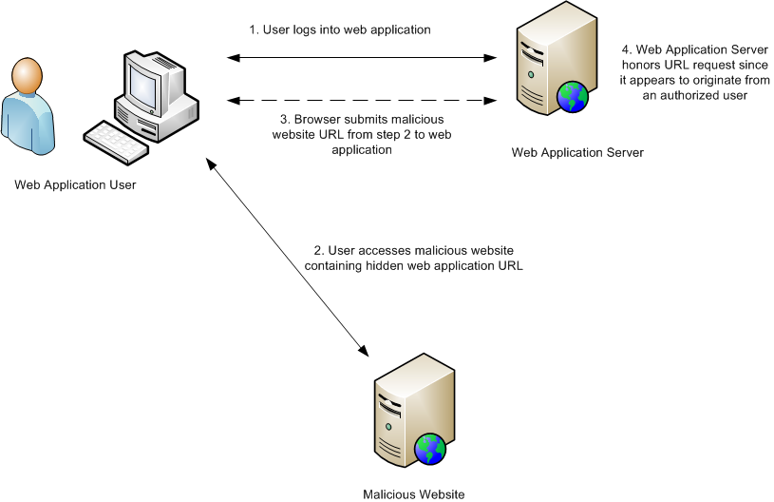
https://support.ptc.com/help/windchill/Whindchill-FHC/en/FlexPLM_Help_Center/images/WCConsiderSecureInfrastructure_CSRF.png

Slide 8
Csrf RELIES ON
Web browser behaviour
Attacker’s knowledge of valid web application URLs, requests or functionalities
Application session management

Slide 9
HAVE FUN WITH SOME PRACTICAL EXERCISES
Complete the suggested exercises of the Intermediate Level of the Broken Access Control learning path

Slide 10
QUESTIONS
In this little section you will find some simple questions to test your comprehension of the topic.
Name some broken access control vulnerabilities and briefly describe them
Simply describe the necessary steps for a CSRF attack
Explain how a malicious request can be embedded in a web page and be automatically sent when visiting it

